Slide 1

DAYOU DSW5008
Small capacity G-PON OLT
Summary
Main function
DAYOUPLUS DSW5008 is a small capacity OLT system that provides up to 8 G-PON ports to provide FTTx service at low cost.
Various uplink module configurations enable efficient network configuration, and power redundancy support ensures reliable service.
In addition, it provides various multiservice and QoS related functions for multimedia service.
L2 Features
Port-based VLAN, IEEE 802.1q Tagged VLAN
VLAN stacking (Q-in-Q)/VLAN Translation
802.1p packet priority
Spanning Tree Protocol(STP/RSTP/MSTP)
802.3ad Link Aggregation Control Protocol
Self loop detection
L3 Features
Static Routing, RIP v1/v2, OSPF v2, BGP v4, VRRP
Multiple default gateway
G-PON
Compliance with G-PON OLT ITU-T G.984
ITU-T G.984 OMCI. ITU-T 984.3 DBA(SR/NSR)
Up to 60Km logical reach, 128bit AES, FEC
ONU/ONT management : Vlan operation, QoS,
filter, Rouge ONU, VoIP(SIP), SW upgrade
Redundancy
Control/Switch redundancy (Active/Standby)
GPON-Link redundancy
Multicast
IGMP v1/v2/v3
IGMP snooping / IGMP static join
IGMP redundancy proxy
PIM-SM/SSM
QoS
Classification
L2 : SRC/DST MAC, Ether type, 802.1p priority, VLAN ID
L3 : SRC/DST IP, TOS, DSCP, IP Precedence
L4 : SRC/DST TCP/UDP port, ICMP
Mark/remark/policing
Traffic scheduling (SPQ, WRR, SPQ+WRR, DWRR)
8 queues per port, Mark/remark/policing
Traffic policing and shaping, Rate limiting
Security
ALC (Access Control Lists)
Storm control (broadcast, multicast, DLF)
IP packet filtering, DoS Protection
NetBIOS, NetBEUI, NBT, CIFS, SSDP, WSDD filtering
Management
CLI(serial / Telnet)
Dual OS (firmware)
Remote OS upgrade (FTP/ TFTP)
Multiple configuration files
Remote configuration upgrade (FTP/TFTP)
Port/Protocol mirroring
SNMP v1/v2/v3
RMON history
Syslog
DHCP server, relay agent with option82
RADIUS, TACACS+, SSH
PPPoE Intermediate Agent
Ethernet OAM (802.3ah EFM Standard Full support)
[DSW5008]
Interface
The FTTH service can operate up to 8 G-PON ports and 4 1G/10G (SFP, SFP +) uplink ports.
High performance service
It maintains high speed non-blocking switch fabric performance reliably and supports up to 120Gbps switching capacity and 89Mpps speed.
Redundancy
Power redundancy ensure stable service.
Network and system management
SNMP v1 / v2 / v3 and MIB II can be applied to simplify network management from a remote location.
OS (firmware) upgrade is available through CLI and USB port, further enhancing the convenience of system configuration and operation.
Security function
The administrator authentication protocols RADIUS and TACACS + ensure that only authorized users can access the relevant equipment, enhancing the security of system management and network management.
DAYOU PLUS all right reserved.
Dayou and Dayou logo are registered trademarks of Dayou. All other trademarks are the property of Dayou, Inc or their respective companies.

Slide 2
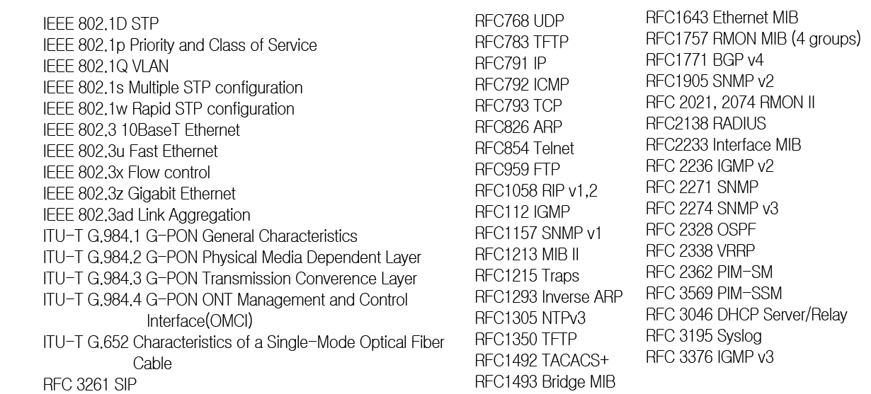


DAYOU PLUS G-PON OLT SERIES
Specifications
Protocol
Memory
RAM 2Gbyte
FLASH 512Mbyte
Interface
4ports 1G/10GbE (SFP,SFP+)
8port GPON
Power
Operating Power AC 88V~264/ VAC
50~60Hz Free Voltage
Power Consumption 540Watts(5V * 6A)
Operating Temperature 0℃ ~50℃
Operating Humidity 10 ~ 95%(Non-condensing)
Dimensions
Dimension(W/H/D) 440mm x 45mm x 295mm
Warranty
One-year(12month) return to factory parts
Performance
120Gbps Switching fabric, 89Mpps Throughput
96K MAC address
4K 802.1Q VLAN, 16K L3 Table(V4), 8K L3Table(V6)
16K LPM(V4), 8K LPM(V6)
1K Multicast(L2), 4K Multicast(L3)
Protocol
Ordering Information
Contact Information
Website: http://www.dayouplus.com
E-mail : sales@dayouplus.com
DAYOU PLUS
3F, 509, Dunchon-daero, Jungwon-gu, Seongnam-si,
Gyeonggi-do, Korea. 462-806
Tel : +82-31-737-7000 / FAX : +82-31-737-7100
DAYOU PLUS all right reserved.
Dayou and Dayou logo are registered trademarks of Dayou. All other trademarks are the property of Dayou, Inc or their respective companies.
Core Network

